Slide 1
Panoptic Segmentation-Based Attention for Image Captioning
Notes:
Dear reviewers, let me introduce our work Panoptic Segmentation-Based Attention for Image Captioning.
This presentation includes 4 parts:
Our motivation
A brief review of the previous image captioning methods.
Our method.
Experimental results.

Slide 2
Motivation:
To develop a fine-grained attention mechanism.
Notes:
Our motivation is to develop a fine-grained attention mechanism, which can better represent images.

Slide 3
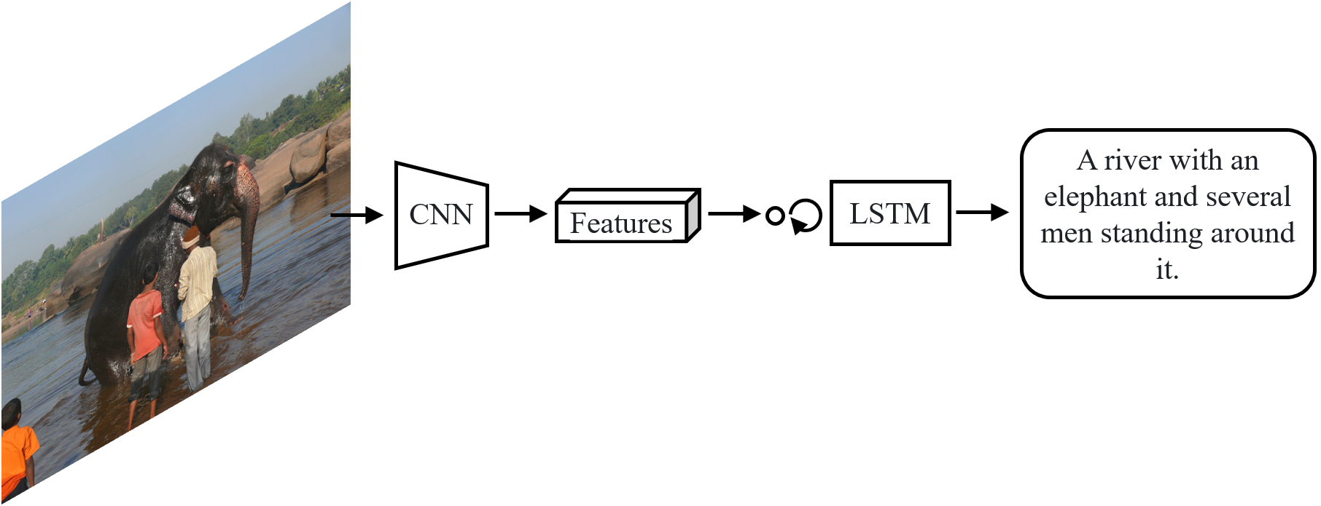
Encoder-decoder framework
Notes:
Before we introduce the previous image captioning method, we first briefly introduce the encoder-decoder framework which is commonly used in image captioning.

Slide 4
Encoder-decoder framework
Encode images into features.
Notes:
In this framework, images are encoded into features vectors, which are then loaded by LSTM to generate captions.

Slide 5
Roadmap of the development of the attention mechanisms in image captioning
Notes:
Now we will review the development of the attention mechanisms in image captioning.

Slide 6
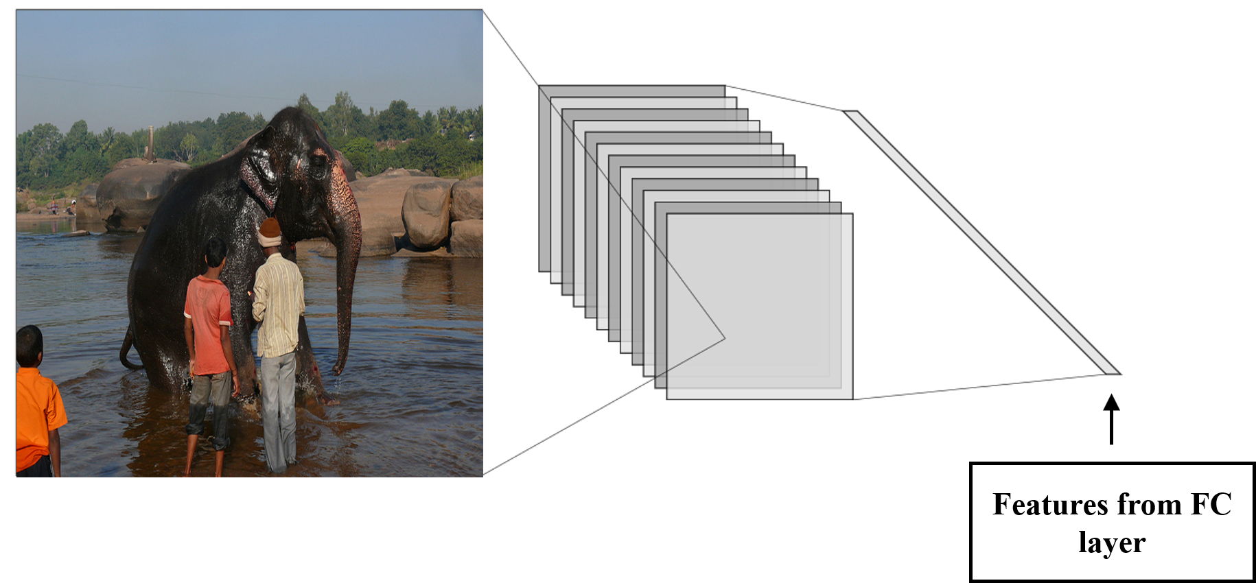
Non-attention methods
Notes:
Early methods take the features from fully-connected layer to represent images. For example, each image is encoded into a vector of shape (1,512).

Slide 7
Non-attention methods
Missing spatial information of the images
Notes:
However, such representation lacks the spatial information of the images.

Slide 8
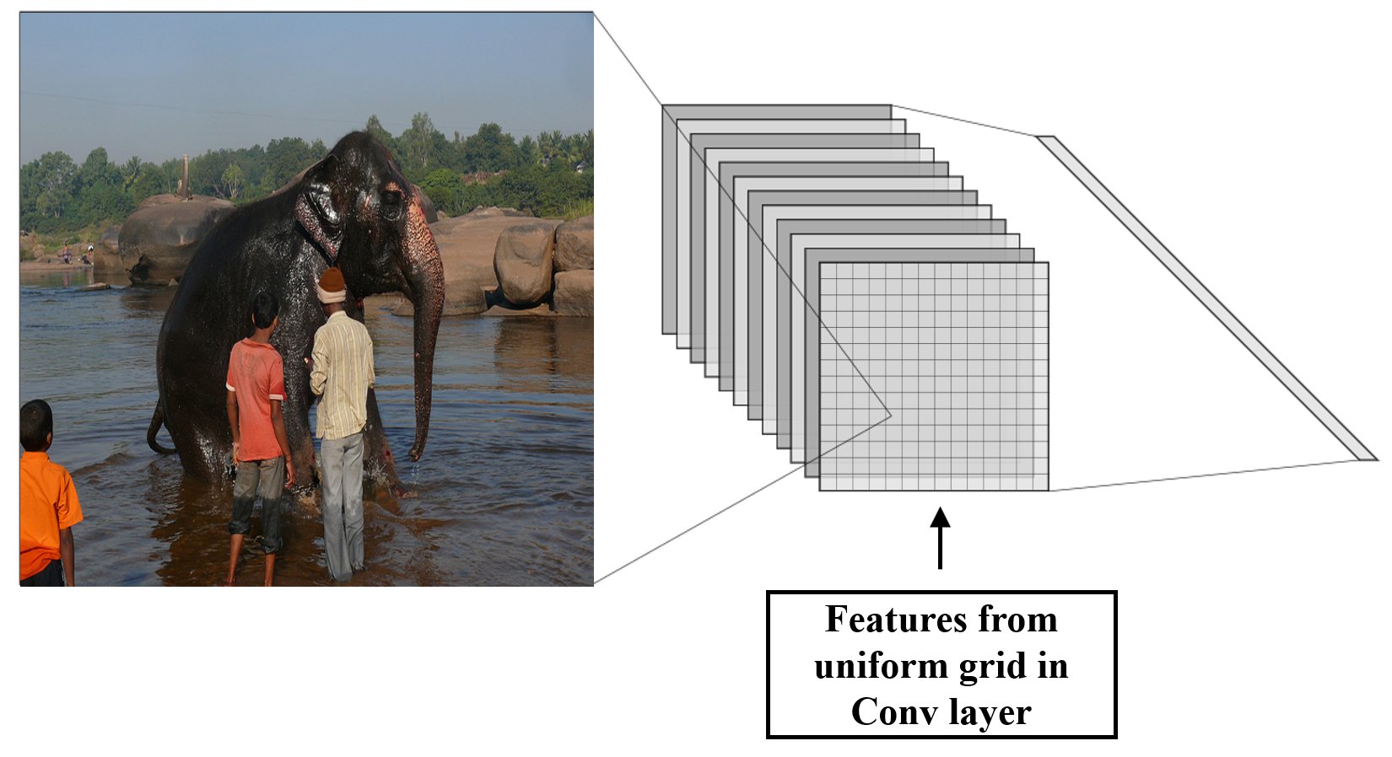
Spatial attention mechanism
Notes:
The first attention-based method takes the features from the last convolutional layer to represent images. For example, each image is encoded into a vector of shape (14, 14 , 512).

Slide 9
Spatial attention mechanism
The uniform grid does not correspond to the content of the images
Notes:
However, such representation does not correspond to the content of the images.

Slide 10
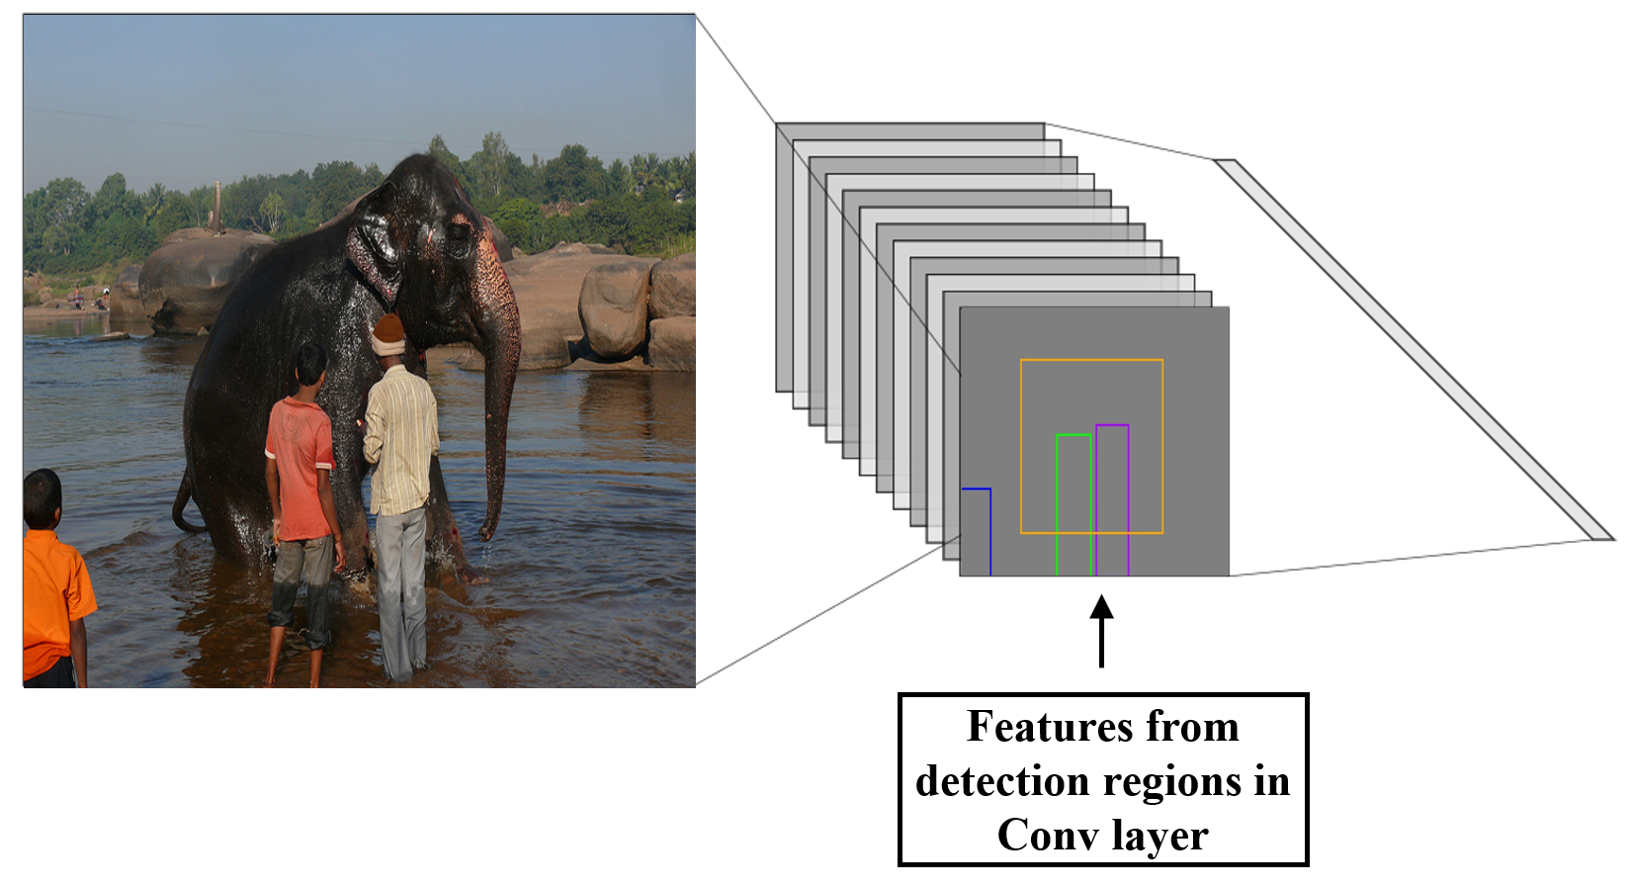
Detection-based attention mechanism
Notes:
The detection-based attention methods take the feature from the corresponding rectangular regions of the feature map. For example, each image is encoded into a vector of shape (n, 512).

Slide 11
Detection-based attention mechanism
The retangular attention regions contain irrelevant regions
Notes:
However, the rectangular attention regions are not fine-grained as they contain irrelevant regions (e.g., background or overlapped regions) besides the object.

Slide 12
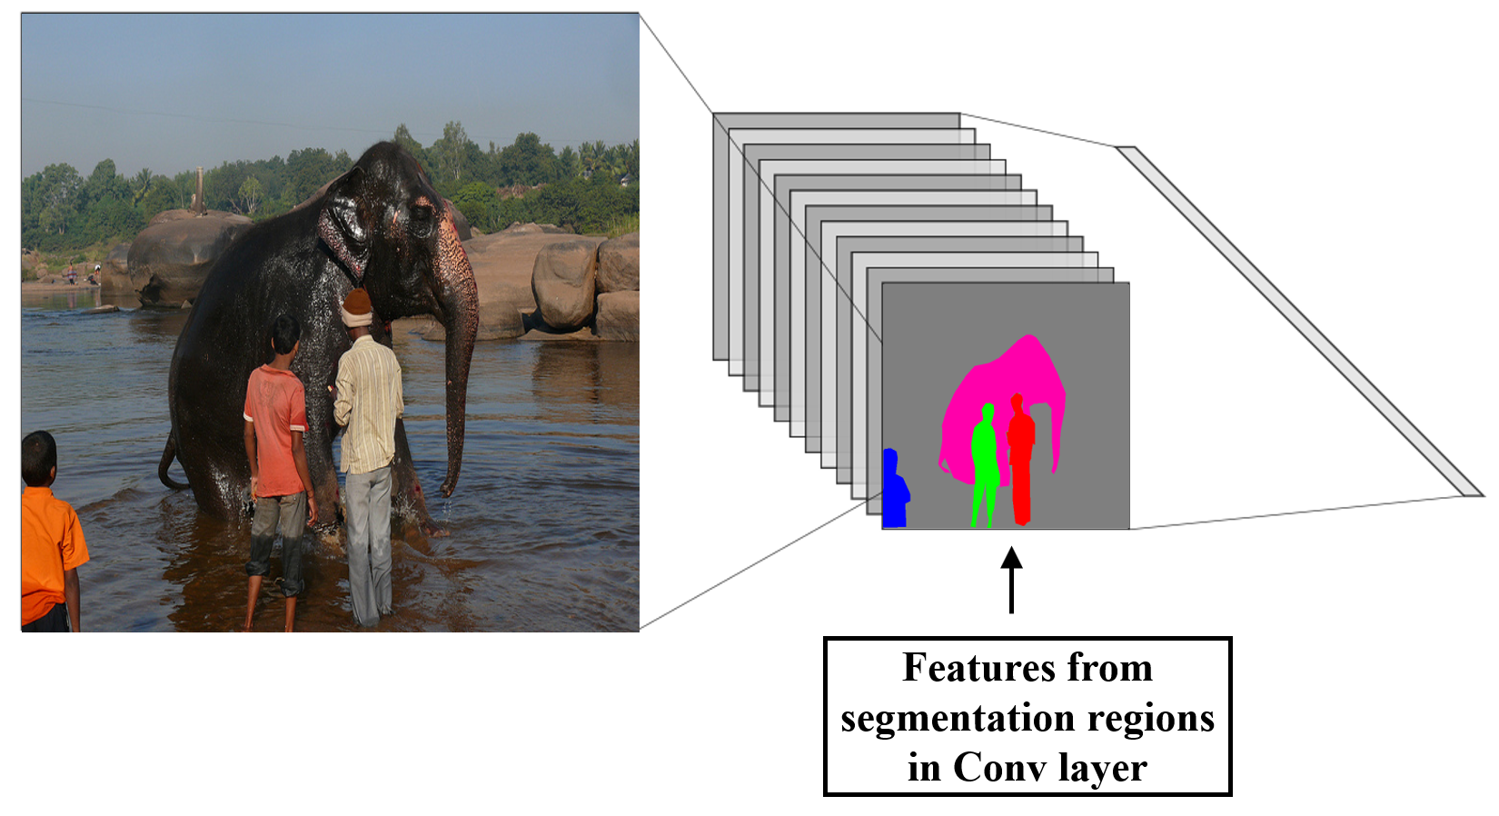
Ours: Instance segmentation-based attention mechanism
Notes:
This is our baseline instance segmentation-based attention mechanism. This method has more fine-grained attention regions compared with the detection-based attention method. The fine-grained regions can better represent the overlapped objects. Each image is still encoded into a vector of shape (n, 512).

Slide 13
Ours: Instance segmentation-based attention mechanism
More fine-grained attention regions without irrelevant regions.
Notes:
With the fine-grained attention regions, model can avoid the negative impact of the background or overlapped regions.

Slide 14
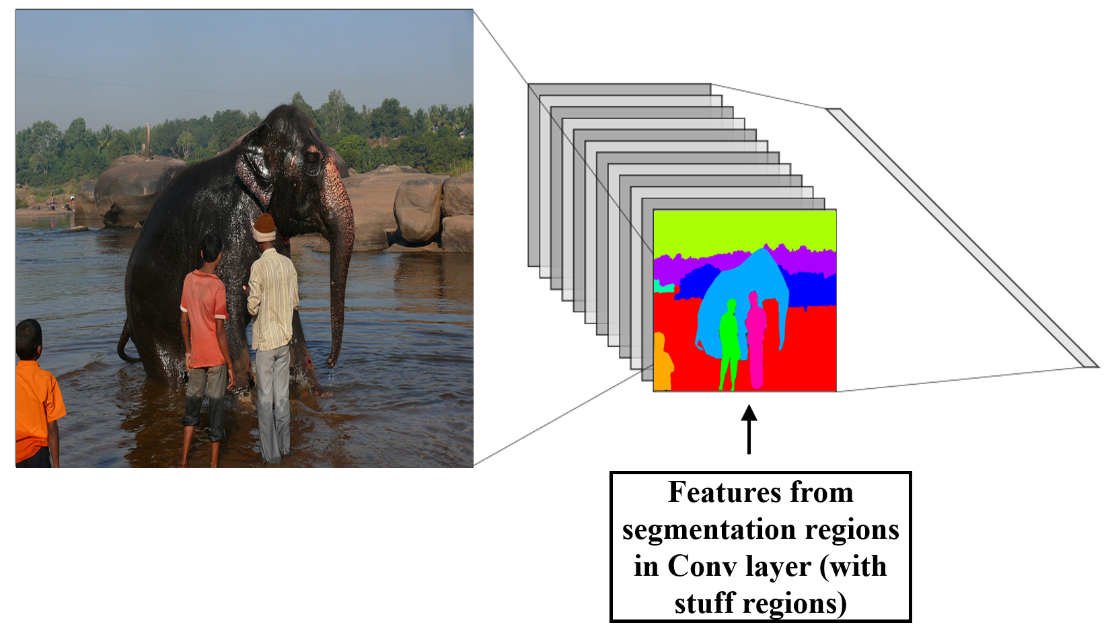
Ours: Panoptic segmentation-based attention mechanism
Notes:
This is our full model. In this model, we not only has more fine-grained attention regions but also incorporates scene information, which haves better representations of images.

Slide 15
Ours: Panoptic segmentation-based attention mechanism
Fine-grained attention regions including background.
Notes:
Scene regions play an important role in the image captioning task as they provide the context information to the model.

Slide 16
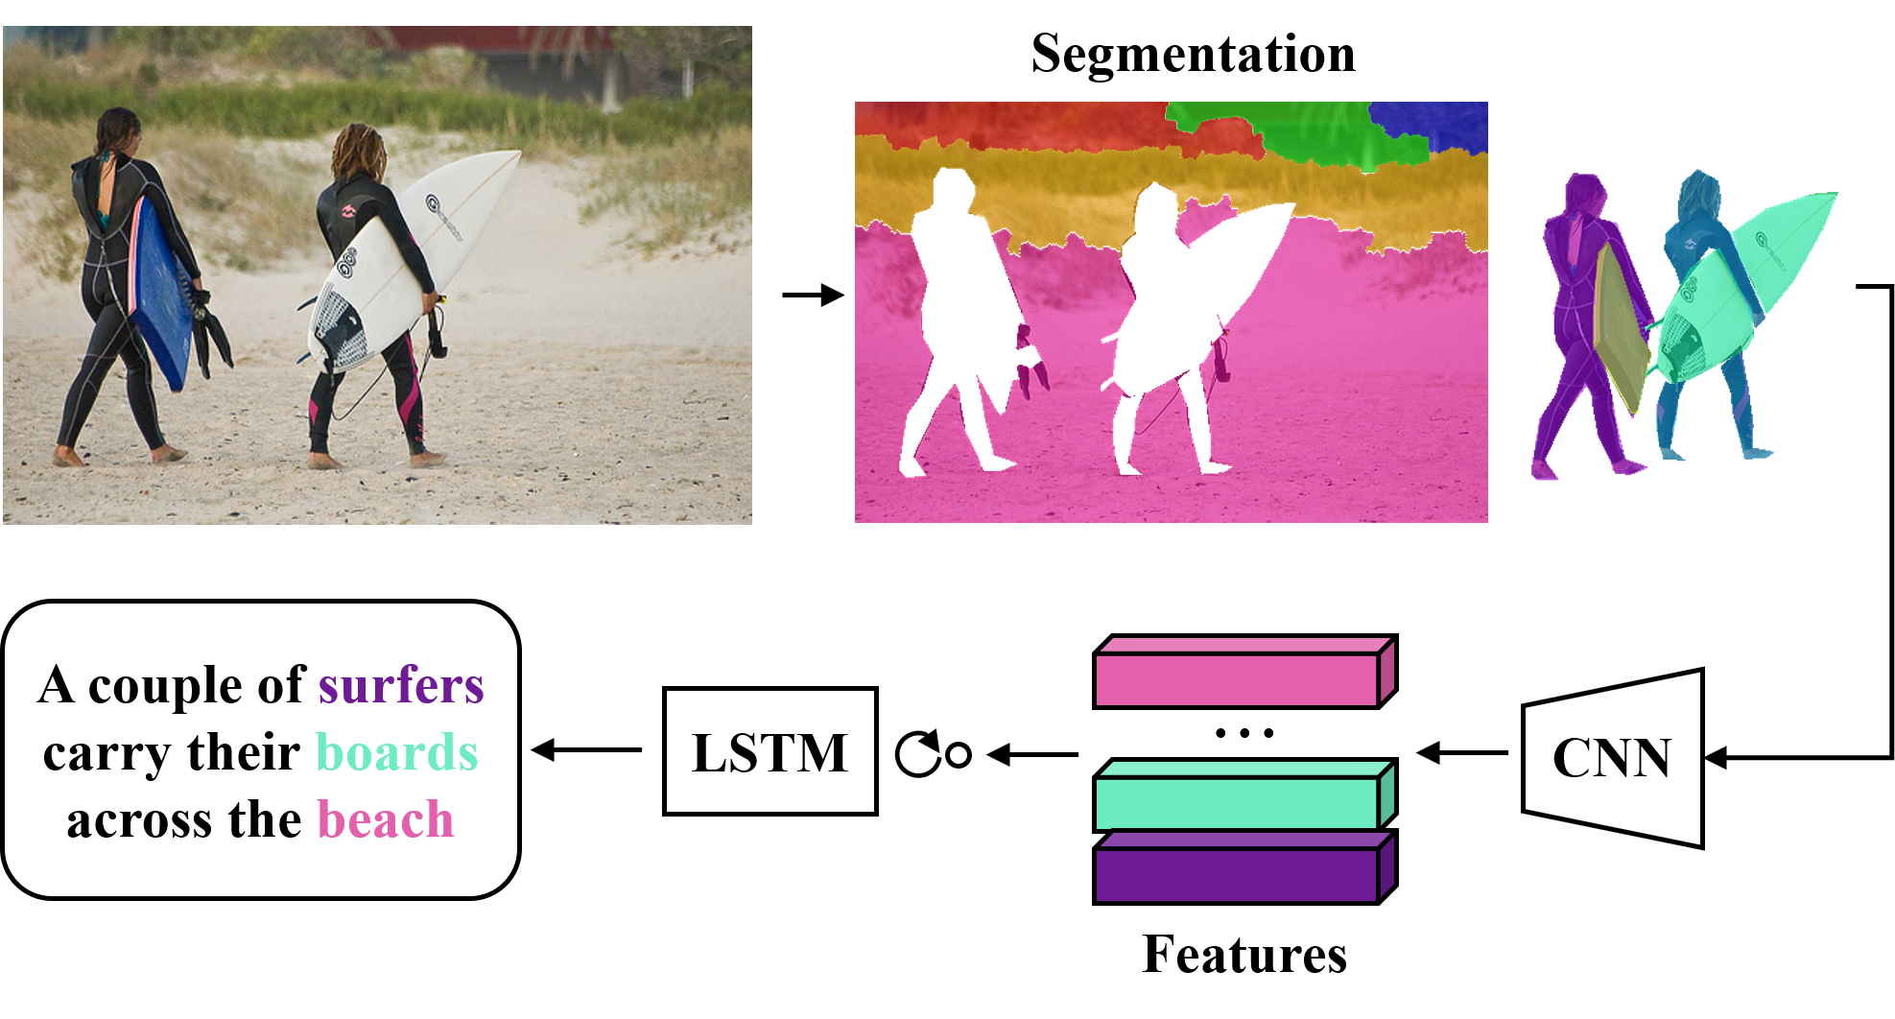
Illustration of our method
Notes:
This is an overview of our proposed method. Given an image, we first generate segmentation regions of the image and use a convolutional neural network to extract the segmentation-region features. For readability, we have applied a color map to each segment. The segmentation-region features are then fed to the LSTM to generate the captions.

Slide 17
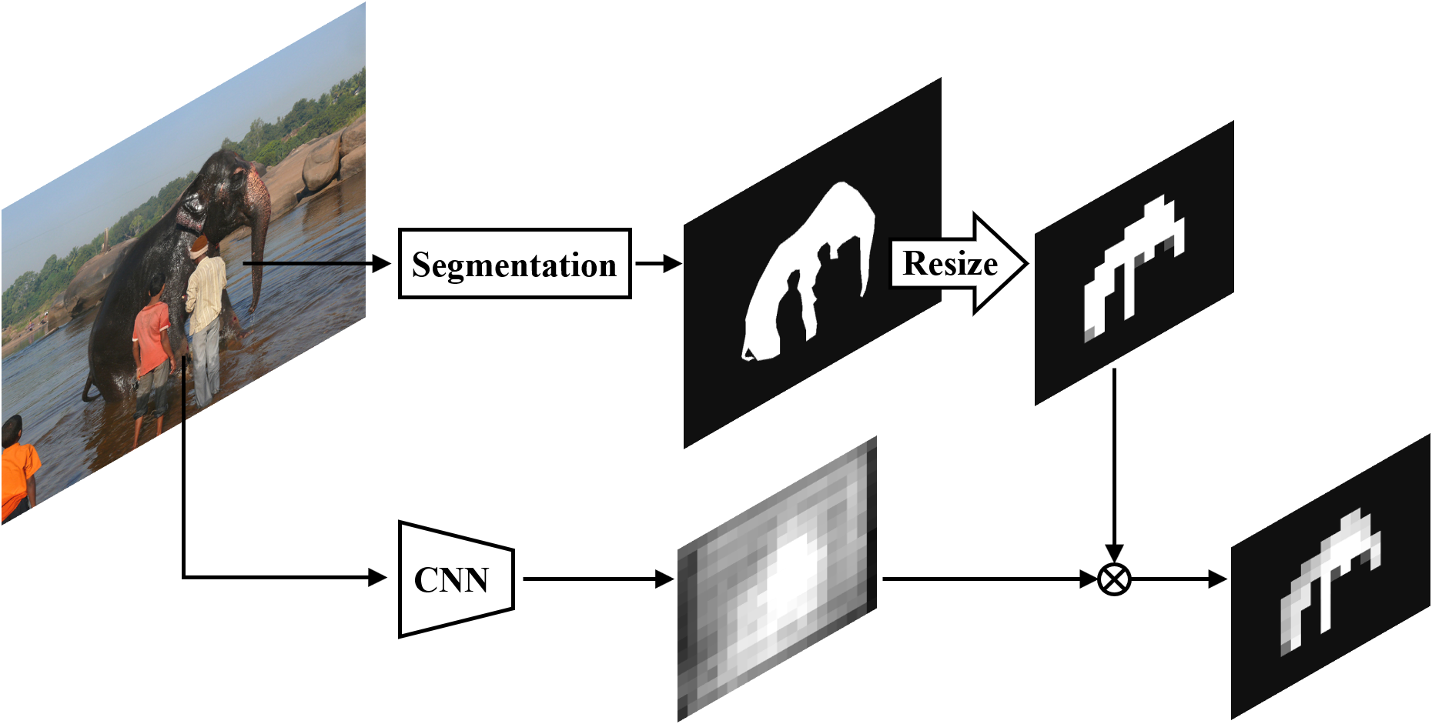
Feature extraction
Notes:
Next, I will introduce how to extract image features. Given a set of segmentation masks and feature map of the image, the feature of segmentation regions are obtained by element-wise multiplication.

Slide 18
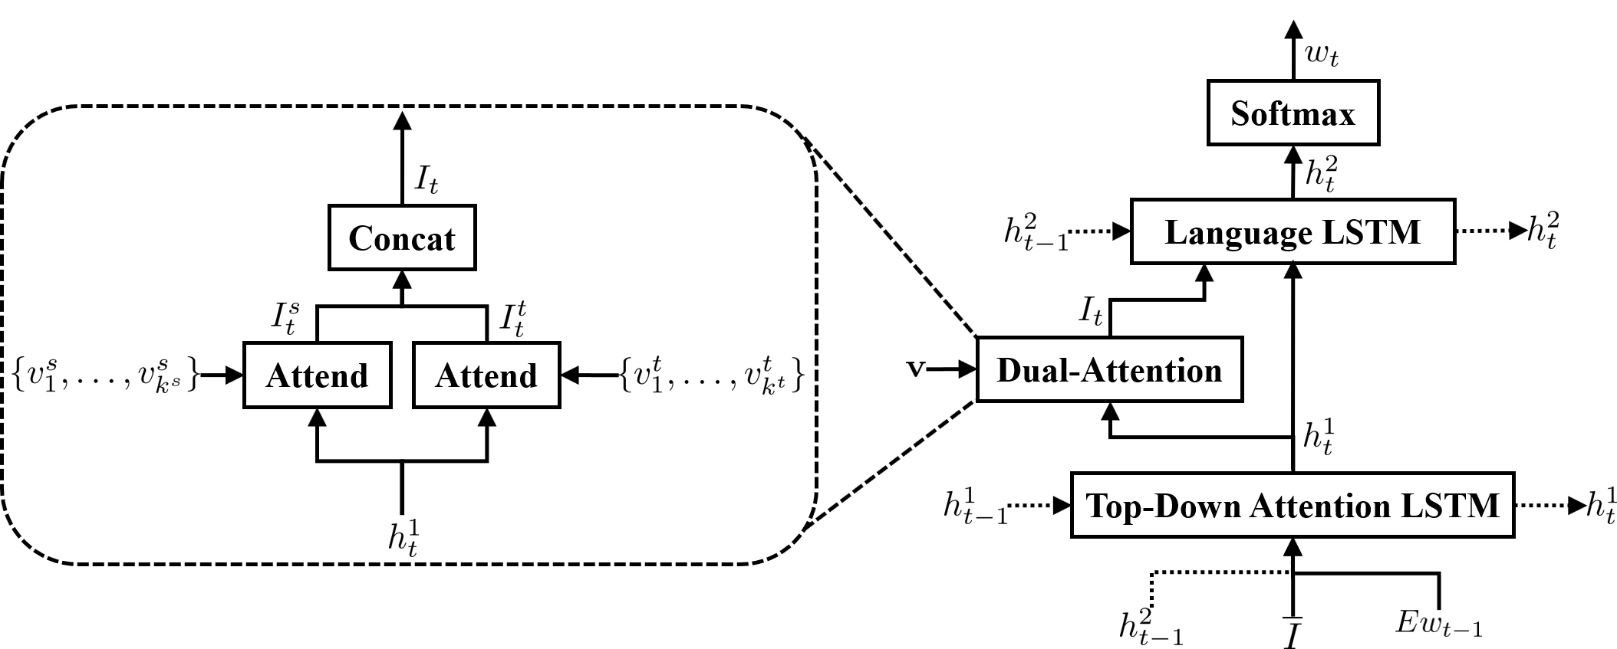
Model architecture
Notes:
Here is our model architecture. Our model consists of two LSTMs and a dual-attention module to process features form foreground ($v^{t}$) and background ($v^{s}$) segmentation regions.

Slide 19
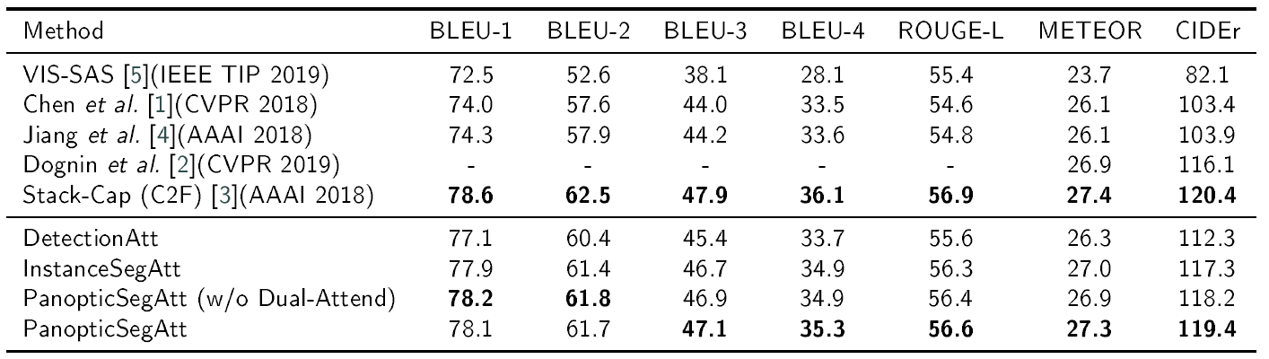
Results
Notes:
This is the evaluation result on MSCOCO offline test set. Our method achieves competitive performance against state-of-the-art methods.

Slide 20
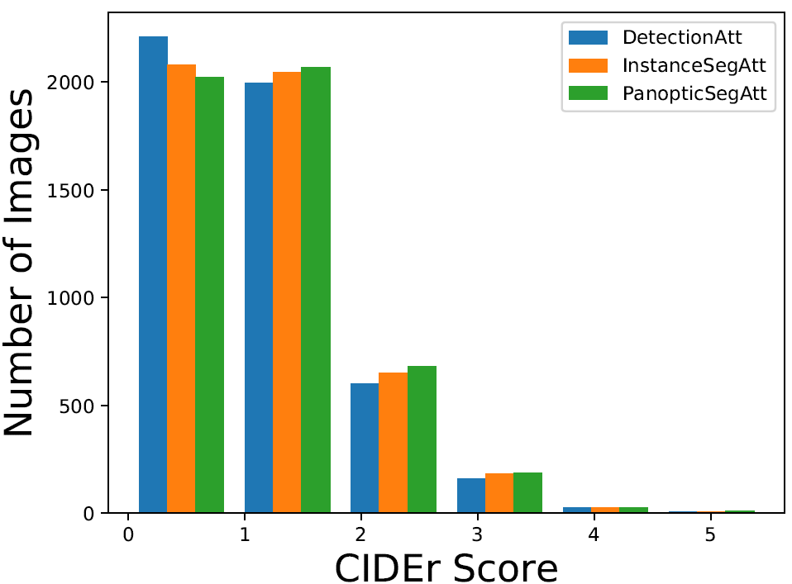
Results
Notes:
In this figure, captions within the interval with a score from 0 to 1 are not accurate enough to describe the images. In the interval with a score from 1 to 3, captions can accurately describe the images. The above results indicate the advantages of using the segmentation features and the stuff regions in our method.

Slide 21
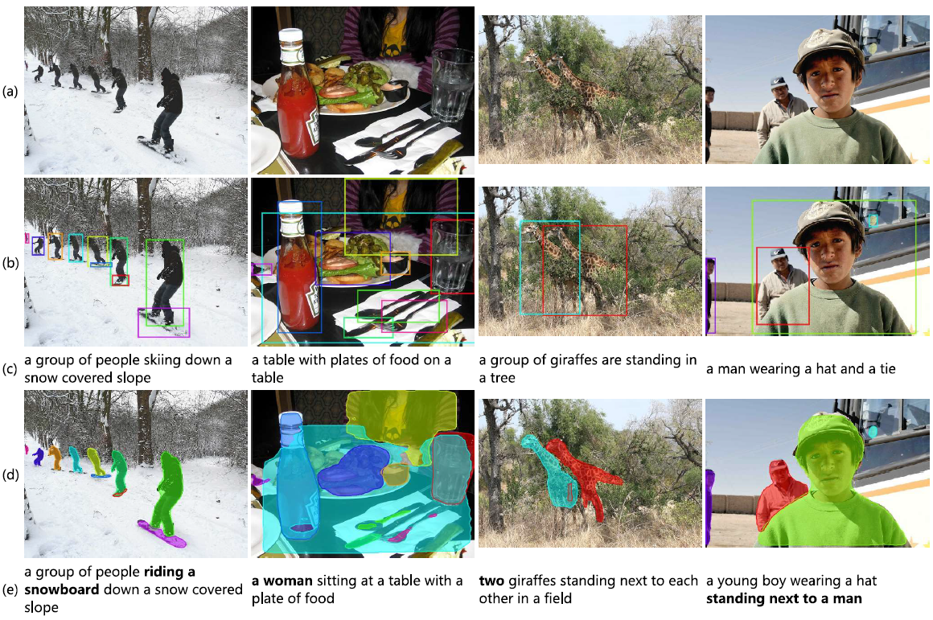
Results
Baseline method
VS.
Instance segmentation-based attention method
Notes:
With the fine-grained segmentation attention region, model is better at handling densely annotated images as the segmentation-region features do not overlap with each other.

Slide 22
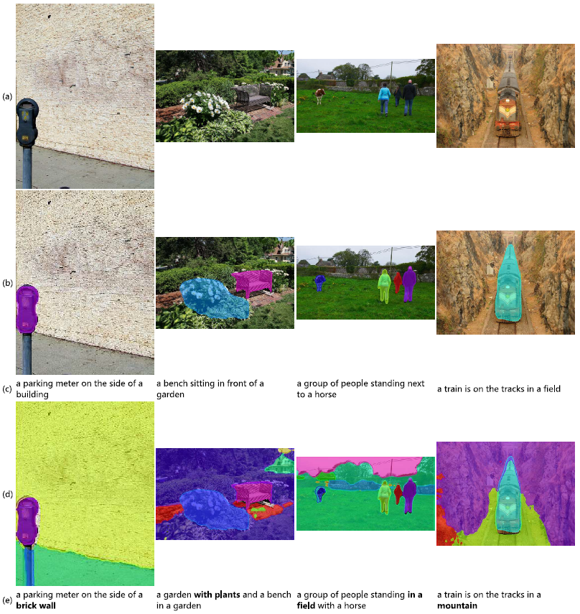
Results
Instance segmentation-based attention method
VS.
Panoptic segmentation-based attention method
Notes:
With the aid of stuff regions, model can generate captions with richer context information.

Slide 23
References
[1] X. Chen, L. Ma,W. Jiang, J. Yao,W. Liu, Regularizing RNNs for caption generation by reconstructing the past with the present, in: Proceedings of the IEEE Conference on Computer Vision and Pattern Recognition, 2018.
[2] P. Dognin, I. Melnyk, Y. Mroueh, J. Ross, T. Sercu, Adversarial semantic alignment for improved image captions, in: Proceedings of the IEEE Conference on Computer Vision and Pattern Recognition, 2019, pp. 10463–10471.
[3] J. Gu, J. Cai, G. Wang, T. Chen, Stack-captioning: Coarse-to-fine learning for image captioning, in: Thirty-Second AAAI Conference on Artificial Intelligence, 2018.
[4] W. Jiang, L. Ma, X. Chen, H. Zhang, W. Liu, Learning to guide decoding for image captioning, in: Thirty-Second AAAI Conference on Artificial Intelligence, 2018.
[5] L. Zhou, Y. Zhang, Y.G. Jiang, T. Zhang, W. Fan, Re-caption: Saliency-enhanced image captioning through two-phase learning, IEEE Transactions on Image Processing 29 (2019) 694–709.

Slide 24
End
Thank you for your time.

